Slide 1

SAGE: Student Academic for Growth and Education
SOA Project Review-1
Date& Time
 | Under the Guidance of Dr.XXXXXX XXXXXX Professor, Department of Computer Science and Engineering, KLH CSE Bowrampet Campus
Team Members Name Roll Number

Slide 2
Outline of Project Work
Focus
Introduction
Literature Survey
Challenges
Research Objectives
Conclusion & Future Work
References
Publications Details

Slide 3
Problem Statement
• Students juggle deadlines across multiple courses, projects, and exams with no single view of what actually matters right now.
• Traditional calendar and to-do apps only display dates — they do not reason about grade weight, urgency, or career relevance.
• Commercial AI planning assistants (ChatGPT Plus, Claude Pro, etc.) require paid subscriptions, putting them out of reach for most students.
• There is no lightweight, free, event-driven system that automatically turns a student's calendar and goals into a prioritized daily action plan.

Slide 4
Objectives
• Design and implement a Service-Oriented Architecture using Spring Boot and Spring Cloud (Eureka, Config Server, API Gateway) to demonstrate real-world microservices patterns.
• Integrate the Google Calendar API as a live data source and automatically detect approaching academic deadlines.
• Build an LLM-based reasoning service (SAGE Brain) that generates a prioritized, context-aware daily digest using the student's profile and career goals.
• Implement asynchronous, event-driven communication between services using Apache Kafka.
• Ensure system resilience with Resilience4j circuit breakers and a zero-cost local LLM fallback (Ollama).
• Deliver the entire system using only free-tier and open-source tools, with full observability via Prometheus, Grafana, and Zipkin.

Slide 5
Literature Survey
Authors | Title of the Paper | Methodology | Inferences | Limitation/Future work
Dragoni et al. [1] | Microservices: Yesterday, Today, and Tomorrow, Springer, 2017 | Literature review and architectural analysis of the evolution from SOA to microservices | Establishes microservices as an architectural style inspired by service-oriented computing; identifies core traits: independent deployability, per-service data ownership, and decentralized governance | Primarily conceptual; does not evaluate a working implementation or provide empirical performance benchmarks
Harshitha et al. [2] | Architecting Event-Driven Microservices: Unlocking Asynchronous Communication with Kafka and RabbitMQ, 2025 | Comparative survey of Apache Kafka and RabbitMQ for asynchronous inter-service communication in microservice systems | Kafka provides high-throughput, distributed event streaming well suited to real-time, loosely coupled service communication such as deadline and digest events | Does not address service decomposition granularity or LLM-driven consumers of the event stream
Sundrababu et al. [3] | Student Learning Assistant Based on Adaptive LLM, IJERT, 2026 | Web-based adaptive LLM assistant offering individualized academic support and auto-generated assessments from syllabus content | Demonstrates that LLMs can personalize academic guidance per student, improving on one-size-fits-all learning platforms | Focused on tutoring/assessment generation rather than calendar-driven task prioritization or event-driven system design

Slide 6
Problem Gap Identification
• Existing academic planners (Google Calendar, Notion, generic to-do apps) are passive — they display information but never prioritize it.
• Existing AI assistants require paid subscriptions, which most students cannot justify for a single planning use case.
• No current tool combines live calendar data with a career/skill profile to generate context-aware, explainable priorities.
• Most academic tools are monolithic and do not demonstrate or scale using modern distributed-systems patterns such as service discovery, event streaming, or resilience engineering.
• SAGE addresses this gap by pairing free-tier LLM reasoning with an event-driven microservices architecture purpose-built for a student's real academic context.

Slide 7
Innovation, Creativity, and Novelty
• Career-aware prioritization: SAGE ranks tasks not just by due date but by grade weight and alignment with the student's stated career goal.
• Dual-LLM resilience design: a free cloud LLM (Groq) serves as the primary reasoning engine, with an automatic, zero-cost local fallback (Ollama) triggered via a Resilience4j circuit breaker.
• Fully event-driven core: deadline detection, digest generation, and notification delivery are decoupled through Kafka rather than tightly coupled synchronous calls.
• Zero-cost architecture: every component — service discovery, messaging, caching, observability, and the LLM itself — runs on free-tier or self-hosted infrastructure.
• Transparent AI reasoning: every generated priority includes a plain-language rationale, so the student sees why a task was ranked highly, not just what to do.

Slide 8
Feasibility and Project Plan
All core components — Spring Boot, Spring Cloud, Kafka, PostgreSQL, Redis, and Docker — are open-source and self-hosted at zero cost. The Groq API and a local Ollama fallback eliminate LLM subscription fees, and the Google Calendar API and Gmail SMTP operate free within their standard quotas. The project is scoped to a single, demonstrable core loop — calendar deadline to AI-generated digest to notification — making it feasible to build end-to-end within a four-week academic timeline.
Phase | Duration | Key Deliverable
1. Architecture Foundation | Week 1 | Eureka Server, Config Server, and API Gateway running; landing page built
2. Identity & Data Services | Week 2 | Google OAuth2 login; Calendar Ingestion and Profile services live with real data
3. Intelligence Core | Week 3 | Kafka event bus wired; SAGE Brain generating real AI-driven priority digests
4. Delivery & Reliability | Week 4 | Notification delivery, Resilience4j fallback, full observability stack, final demo

Slide 9
Dataset and Data Sources (1 of 2)
SAGE does not use a traditional static ML training dataset — it reasons over the student's own live planning data, collected from multiple sources.
Data source | What is captured | What SAGE uses it for
Task Data | Task title · deadline · effort estimate · importance · status · snooze count | Backbone of the daily plan — priority ranking, time-block sizing and snooze-pattern detection
Recurring Goals | DSA practice · online courses · personal learning goals · daily and weekly practice targets | Auto-injected into every future plan without the student re-entering them
Google Calendar Data | Classes · labs · exams · other fixed commitments | Computes the student's real available study time

Slide 10
Dataset and Data Sources (2 of 2)
Data source | What is captured | What SAGE uses it for
Codeforces Data | Upcoming contests · contest start time · contest duration · contest information | Injected into the plan as fixed-time events that cannot be moved
Student Behaviour Data | Completed tasks · skipped tasks · snoozed tasks · repeated snoozes | The system's only learning signal — drives adaptive rescheduling and the snooze-pattern trigger
The PRD defines tasks, recurring goals, Google Calendar events and Codeforces contests as the core inputs to SAGE; behaviour data is what makes the plan adapt over time.

Slide 11
Methodology (1 of 2)
Step 1 — Authentication
– Student logs in using Google OAuth2.
– Auth Service handles authentication and issues a JWT.
– API Gateway validates every request.
Step 2 — Data Collection
– Tasks are created through the frontend.
– Recurring goals are stored.
– Google Calendar provides fixed commitments.
– Codeforces provides upcoming contests.
Step 3 — Data Integration
– Planning Service combines tasks + goals + calendar events + contests + available time into one input set.

Slide 12
Methodology (2 of 2)
Step 4 — Plan Generation
– Planning Service produces the priority order, time blocks, the daily schedule, available study time and the overload warning.
Step 5 — AI Reasoning (SAGE Brain)
– Uses the student's current data to explain priorities, answer questions and provide schedule reasoning.
Step 6 — Feedback
– Student selects Done, Skip or Snooze.
– The system records this behaviour and uses it when creating future plans.

Slide 13
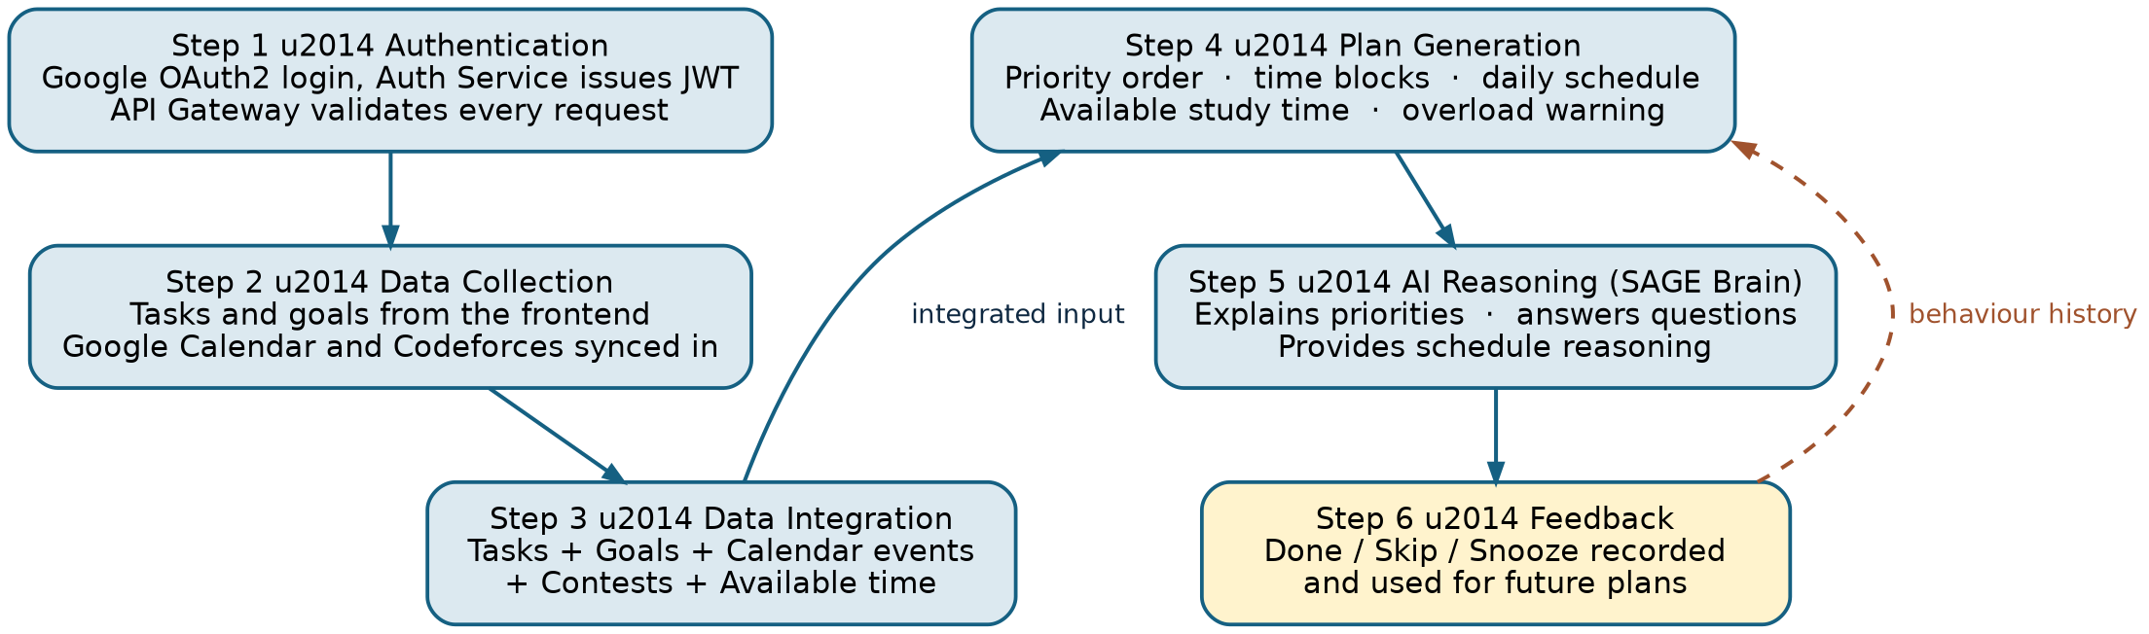
Methodology — Data Flow
Figure 1 — Methodology end to end: authentication, collection, integration, plan generation, AI reasoning and the feedback loop that makes future plans more realistic.

Slide 14
Feature Set — MVP (1 of 2)
# | Feature | What it does
1 | Task management | Create, view and update tasks — title, deadline, effort estimate, importance, status.
2 | Recurring goals | Define once (e.g. “LeetCode, 1 hr/day”); auto-included in every future plan without re-entry.
3 | Today's plan | Time-blocked schedule built from tasks + goals + fixed calendar and contest events, fitted to the student's real available hours.
4 | Overload warning | Explicit alert when planned work exceeds available hours, together with a suggested task to defer.
5 | Done / Skip / Snooze logging | One-tap status update per task — this is the behavioural data source that drives adaptation.

Slide 15
Feature Set — MVP (2 of 2)
# | Feature | What it does
6 | Snooze-pattern detection | After repeated snoozes on one task, SAGE prompts the student to reschedule instead of re-alerting indefinitely.
7 | Codeforces contest sync | Upcoming contests pulled through the official API and injected into the plan as fixed-time events.
8 | Google Calendar sync | Classes and labs pulled as fixed commitments, so real available hours are computed rather than guessed.
9 | SAGE Brain (Q&A) | Natural-language questions answered from the student's own live task, schedule and contest data — never general knowledge.
10 | Contest and task reminders | Configurable lead-time notifications (e.g. 60 minutes before a contest, morning nudge for a recurring goal).

Slide 16
Explicitly Cut from MVP
Cut from MVP | Reason
LeetCode live integration | No official public API — only unofficial, undocumented endpoints exist.
CodeChef live integration | Official API needs approval and is unreliable for a student project; shipped as a stubbed, disabled-by-default provider.
AtCoder live integration | No official API; only a community-run one — optional stretch, clearly labelled unofficial.
Task dependencies | Project-management-level complexity disproportionate to this scope.
Career-relevance scoring | Reduces to a simple tag rather than a modelled subsystem.
Peer benchmarking | Requires an aggregate data pipeline that is not feasible in one semester.
Admin / instructor dashboard | Not core to the single-user student value proposition.
The MVP list is final. New ideas go to a backlog, not into the current sprint.

Slide 17
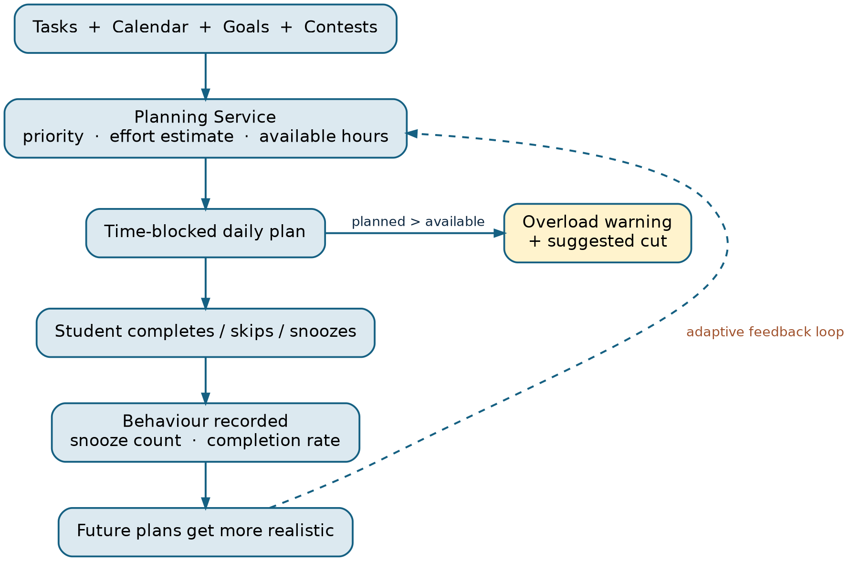
Core Product Loop
Figure 2 — The adaptive loop is the project's central product and technical claim; every other feature exists to feed or surface it.

Slide 18
System Architecture — Microservices
Service | Responsibility | Database | Status
Auth Service | Google OAuth2, JWT issuance, role-based authorisation | auth_db | Already built
Task Service | Task CRUD, recurring goals, status, snooze count | task_db | To build
Integration Service | Pluggable Contest / Profile Provider architecture (Codeforces live, others stubbed) plus Google Calendar sync | integration_db (cache only) | To build
Planning Service (SAGE Brain) | Today's schedule, overload detection, adaptive rescheduling, LLM Q&A | planning_db | To build
Notification Service | Event-triggered contest, task and goal reminders; snooze nudges | notification_db (or stateless) | To build
Why exactly five: each owns a distinct responsibility, data shape and failure mode — transactional CRUD, third-party isolation behind one interface, the only LLM-dependent decision component, and pure event-driven dispatch. No service was added to hit a requirement count.

Slide 19
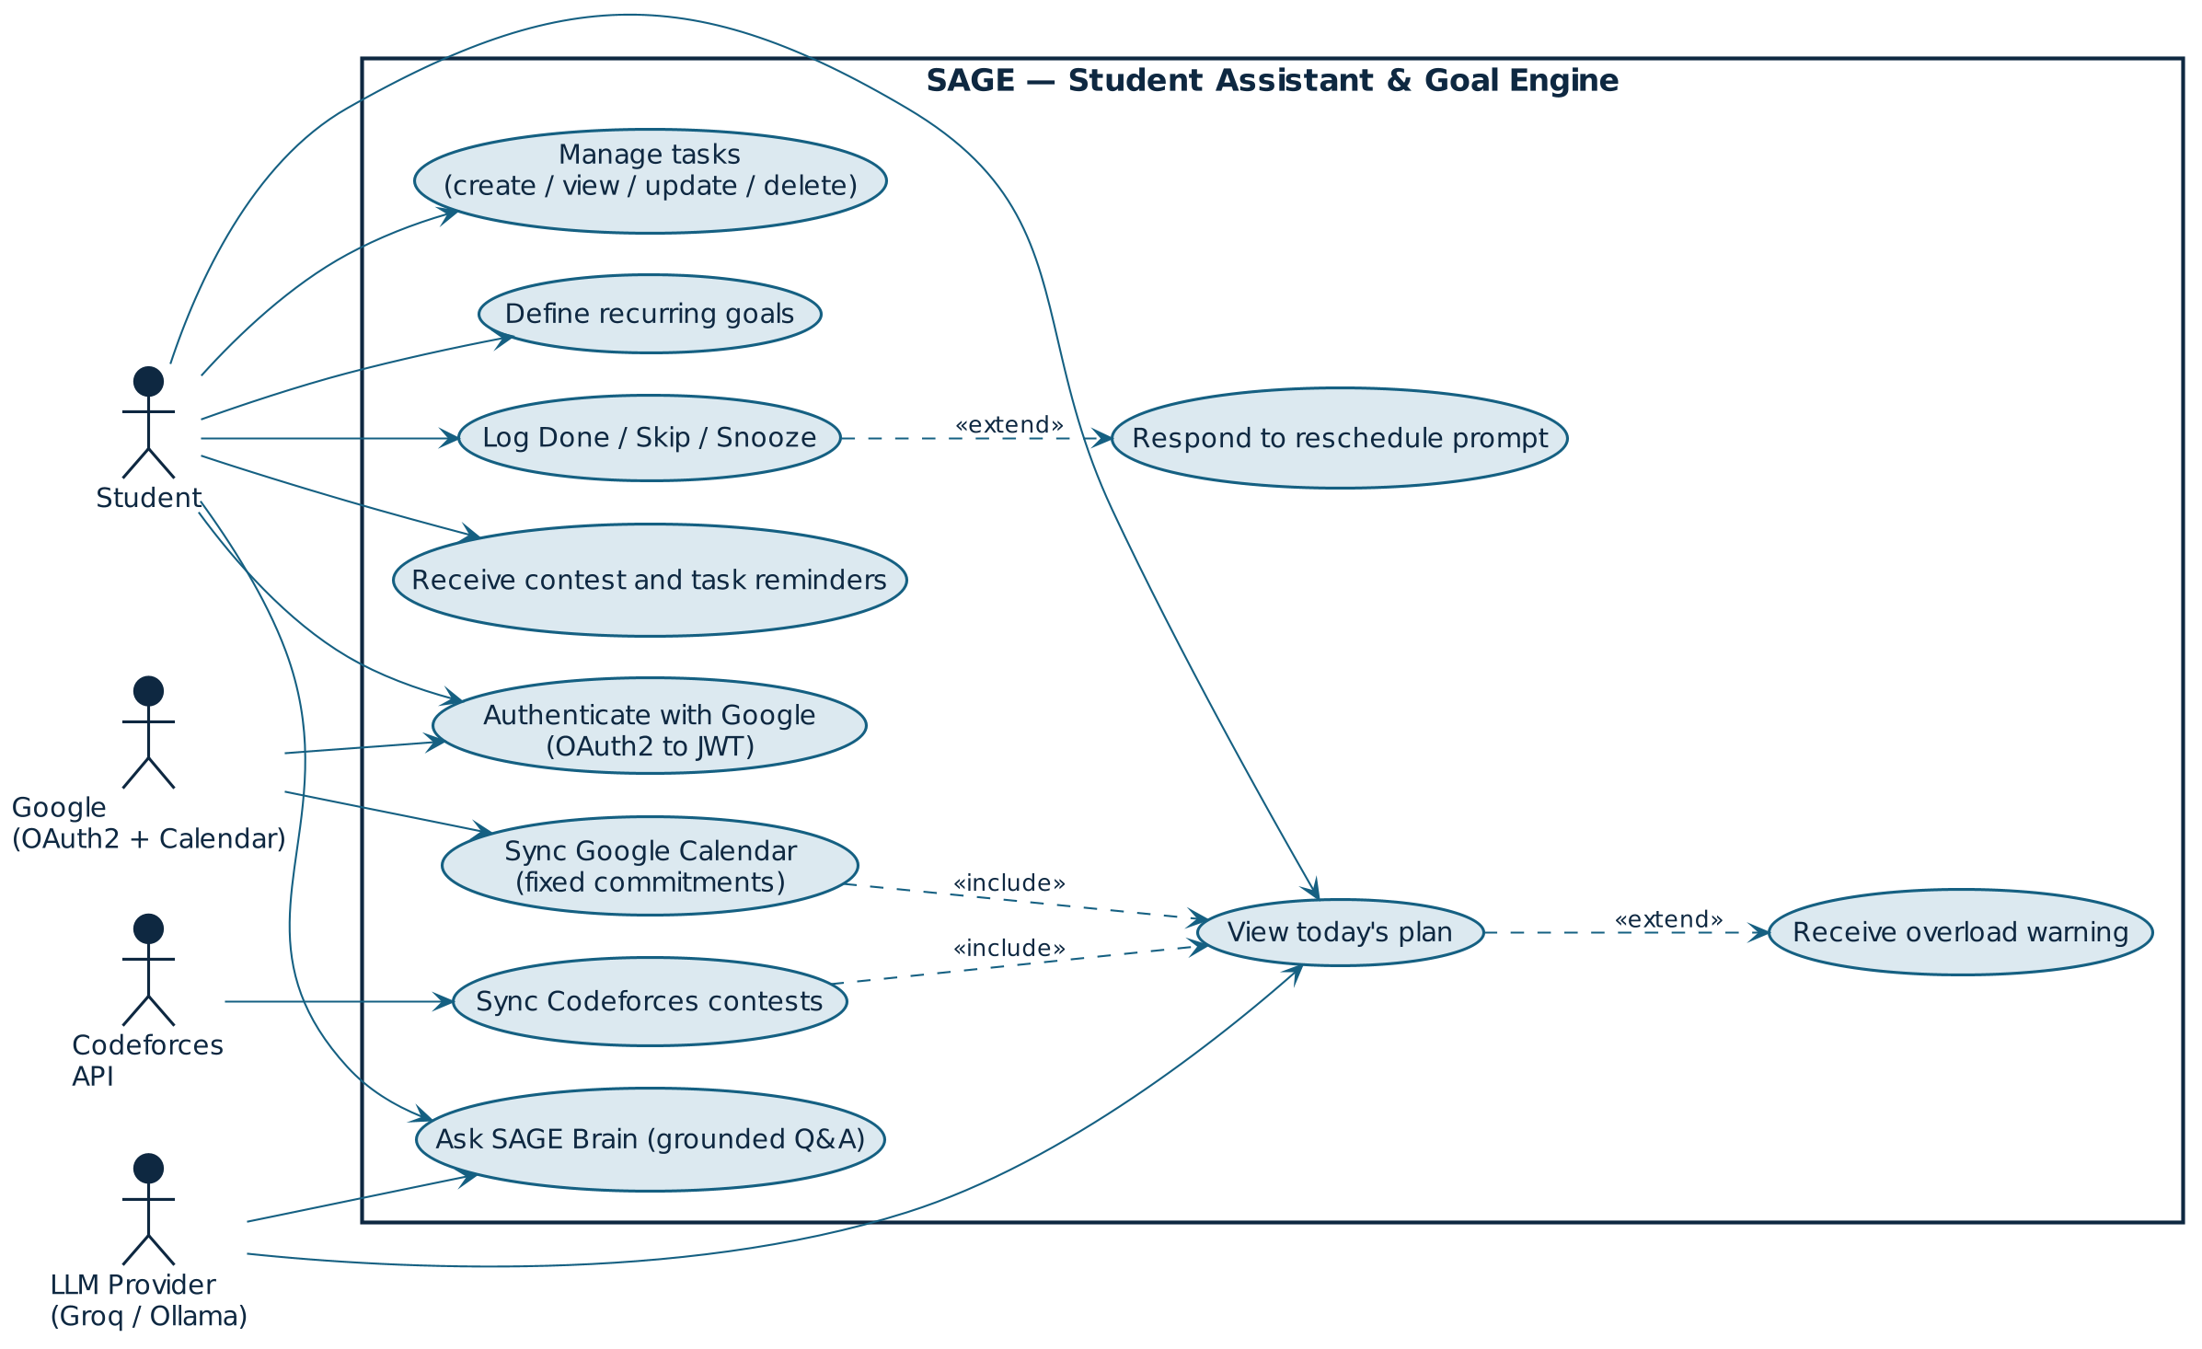
UML Use Case Diagram
Figure 3 — Use case diagram: one primary actor (Student) and three external system actors, with <<include>> and <<extend>> relationships on today's plan and the snooze loop.

Slide 20
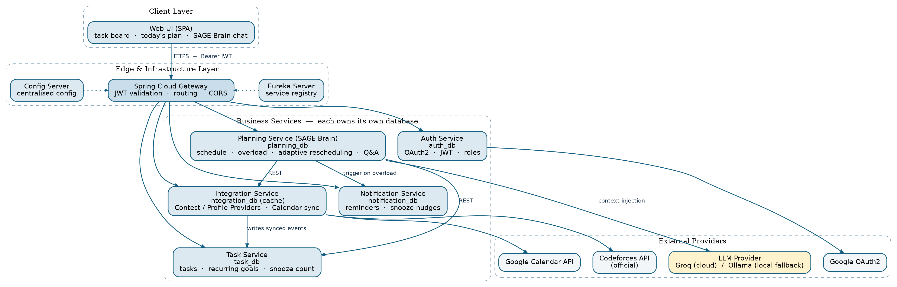
System Architecture Diagram
Figure 4 — Layered SOA: client, edge/infrastructure, five business services (one database each) and external providers. Synchronous REST only — no message broker at this request volume.

Slide 21
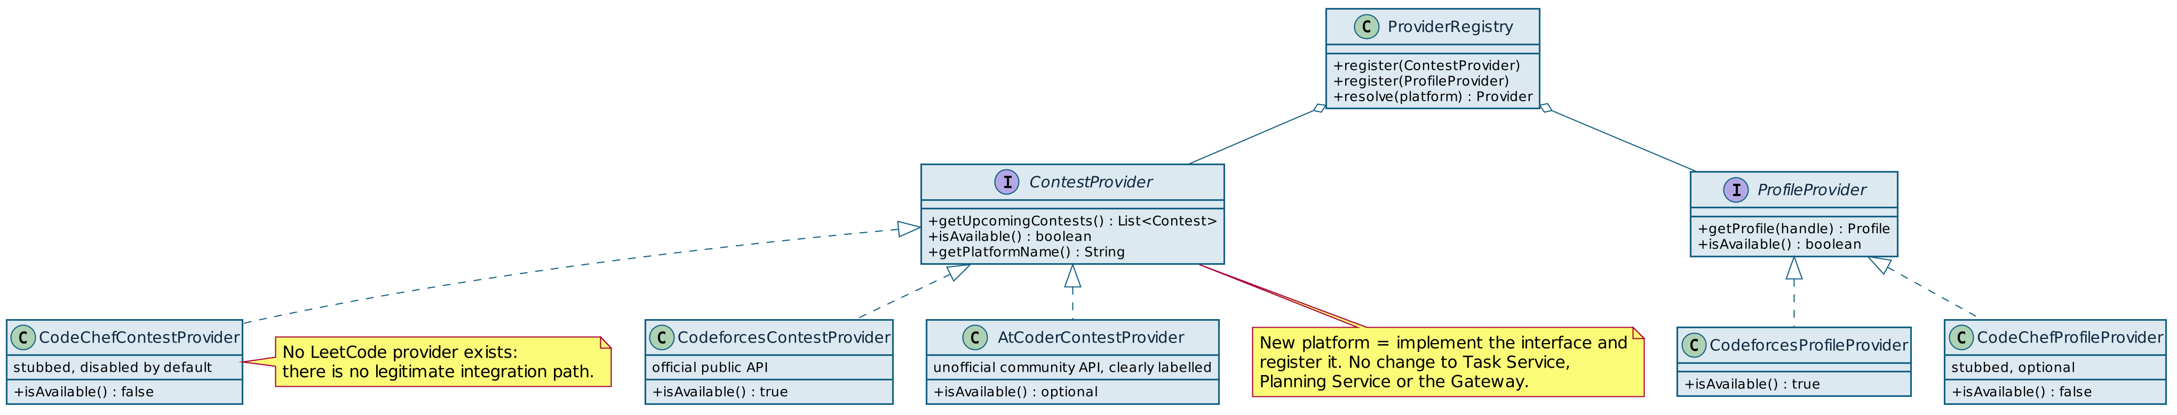
Provider Abstraction — UML Class Diagram
Figure 5 — Contest / Profile provider abstraction: a new platform is added by implementing the interface and registering it, with no change to Task Service, Planning Service or the Gateway.

Slide 22
Success Criteria — Demo and Grading
• Zero tasks to a generated, overload-flagged daily schedule in under two minutes, live on stage.
• A real upcoming Codeforces contest appears in the schedule without any manual entry.
• Snoozing a task three times visibly triggers a reschedule prompt.
• A SAGE Brain question returns an answer that references the student's actual current tasks, not generic text.
• Every microservice has a one-sentence, defensible reason to exist that survives direct questioning.
“Google Calendar shows fixed events. Alarms and contest bots remind you of one thing at a time with no awareness of anything else you have going on. SAGE pulls deadlines, contests, recurring goals and calendar availability into one real plan for today, tells you when you have taken on more than fits, and adjusts when you procrastinate — instead of just re-ringing an alarm.”

Slide 23
Academic Requirement Coverage
Academic requirement | Status
At least 3 microservices (5 delivered) | Done
JWT authentication (Auth Service) | Done
Role-based authorization (Auth Service) | Done
Architecture diagram | Done — this deck
Service contracts and REST endpoints documented | Pending
CORS configuration | Pending
Eureka service registration | Pending
Spring Cloud Gateway routing | Pending
Database per service | Pending
Unit and integration tests | Pending
Postman API testing | Pending
GitHub Actions | Pending
Jira user stories and sprint board | Pending

